Slide 1

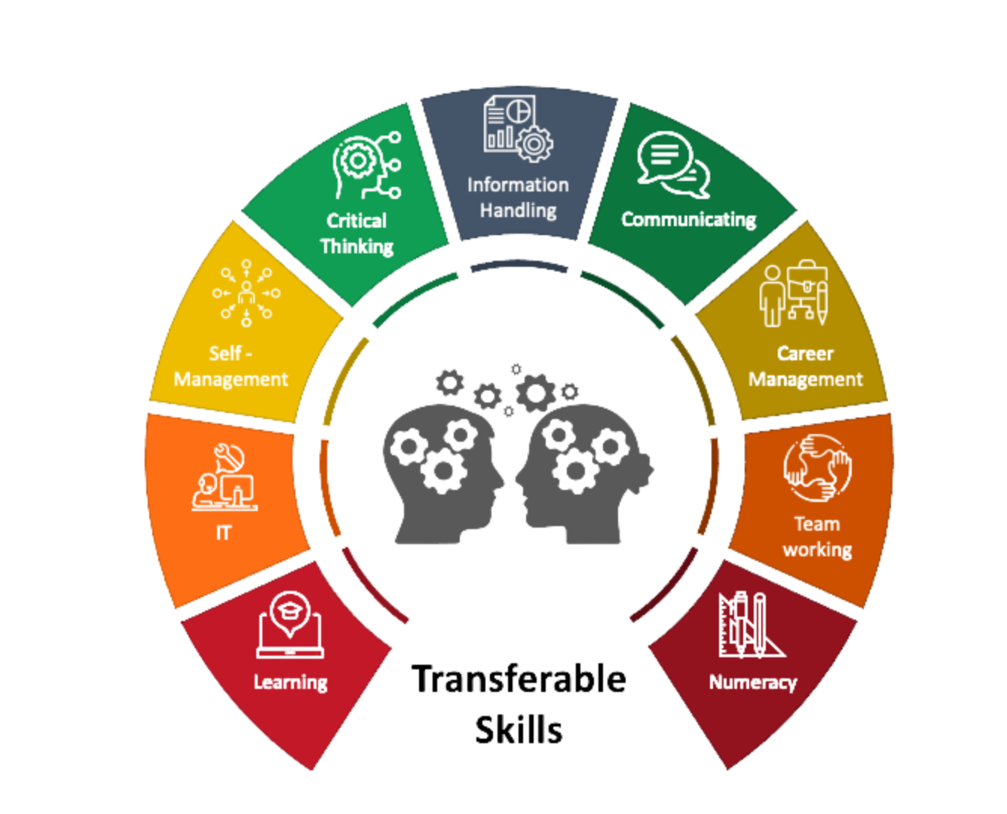
Skills are the knowledge which we all need to use when we work with other people, on projects or even by ourselves.

Slide 3
What are Career Skills?
Career Skills refer to a range of skills that are important in any workplace and are the transferrable ones that we can learn in our everyday life, through hobbies, activities, in education and employment.
The skills we are talking about are quite ordinary, that's why we don't usually notice them - but they are incredibly important.
Knowledge and qualifications might secure you an interview but it is these skills that will ultimately get you the job!
Most people develop these skills without even knowing and all of them can be improved upon. These skills can be divided into People Skills, Task Skills and Personal Skills.

Slide 4
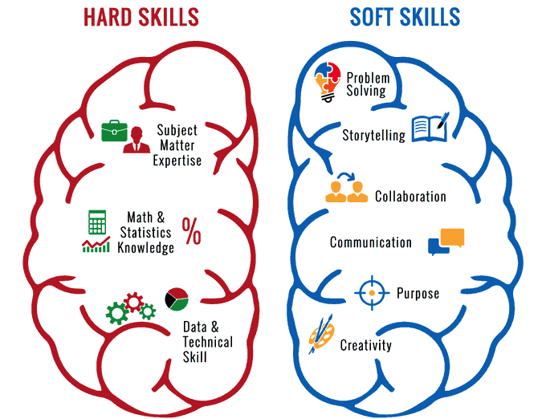
People Skills
People Skills are often referred to as ‘soft’, ‘social’, or ‘interpersonal’ skills. These skills help us to communicate, get along with and be able to understand others.
In a world where increasingly anything that can be automated, will be automated, having strong people skills is consistently one of the the key things that recruiters look for in prospective employees.

Slide 5
Task Skills
Task Skills can sometimes be referred to as ‘hard’ skills. They are learned skills that often help recruiters select and shortlist candidates for interviews.
Task Skills can be used to complete many tasks at the workplaces. Some examples include organising, time management and computer skills. All of these are useful in most jobs and people can develop these through practice.

Slide 6
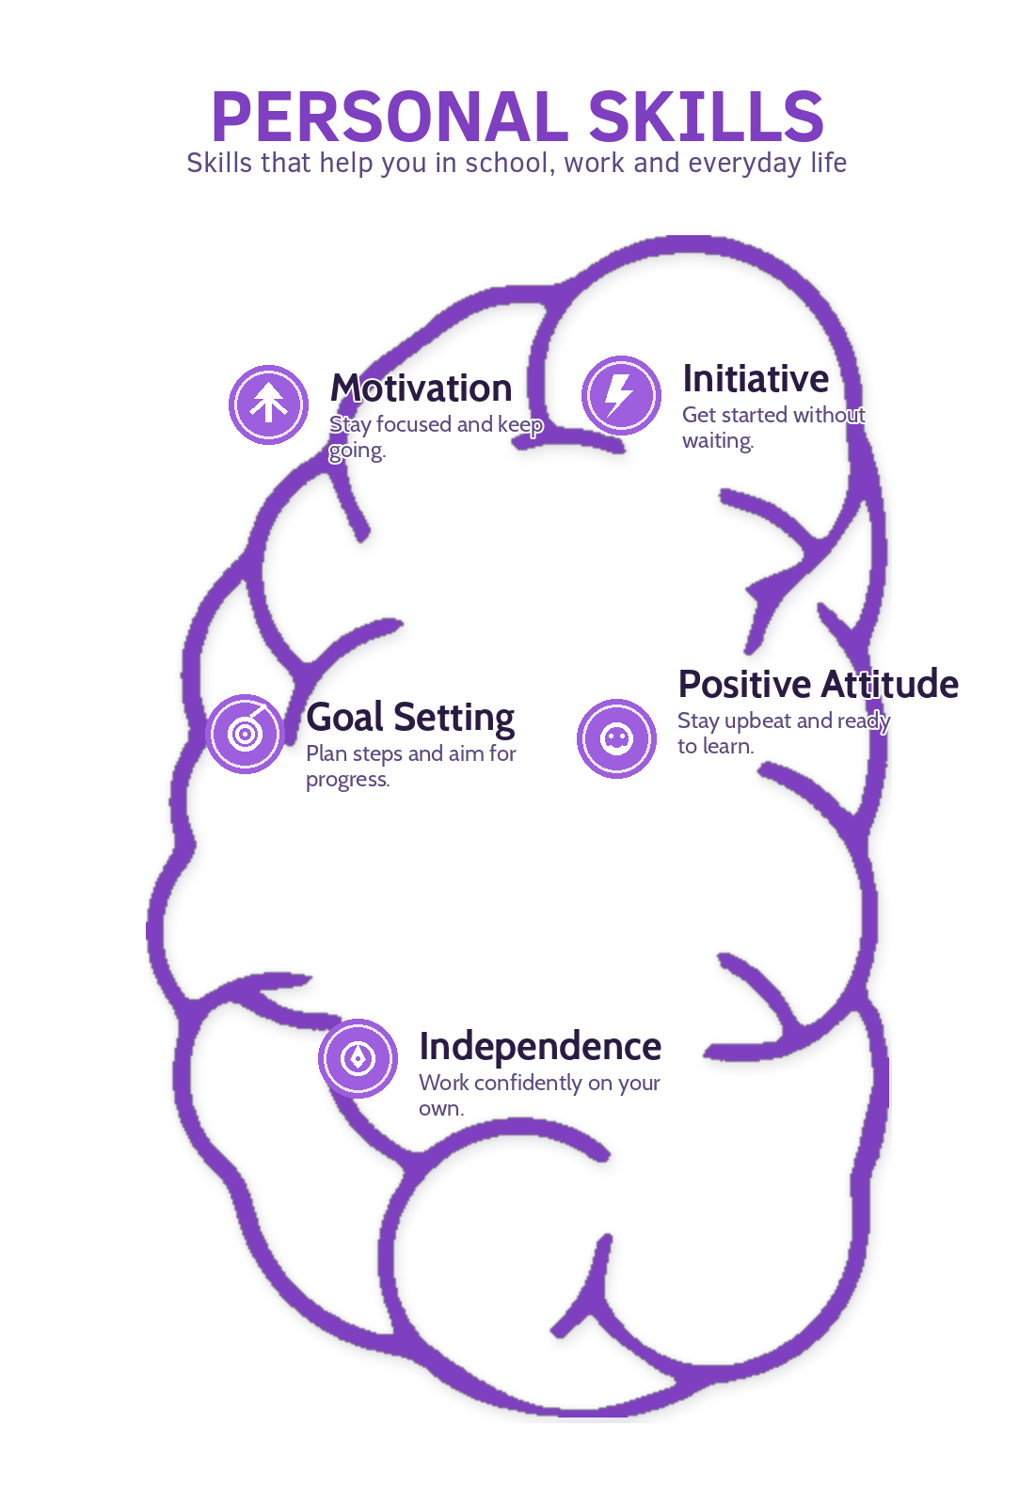
Personal Skills
Personal Skills reflect a person’s attitude and behaviours that they bring to the workplace. How they manage themselves and express themselves while at work.
Individuals with well-developed personal skills are highly-valued by employers, as they are easier to work with. They also help to create a more positive and harmonious working environment which, in turn, becomes a more productive and efficient workplace.

Slide 7

Video on Career Skills

Slide 8
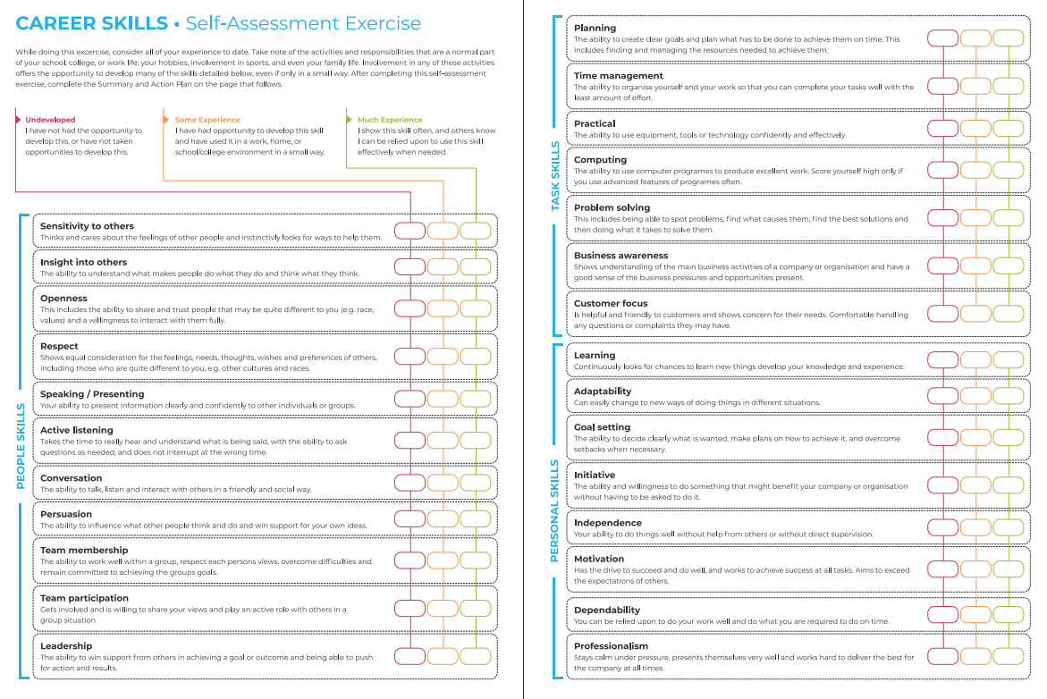
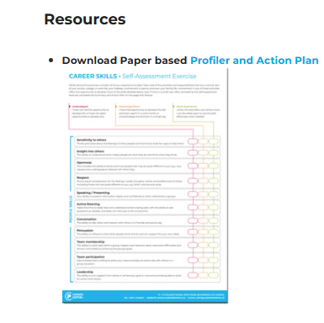
Introduction Written Exercise (Download from Career Skills App)
Rate yourself on each of the 26 Career Skills as:
Undeveloped
Some Experience
Much Experience

Slide 9
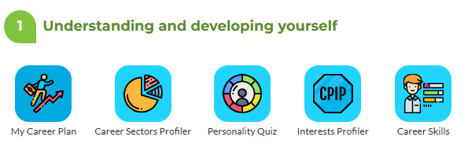
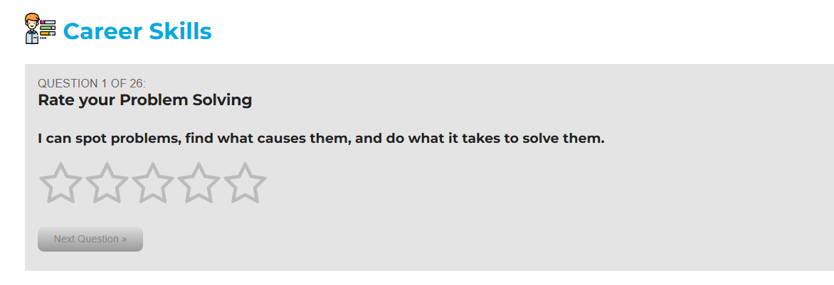
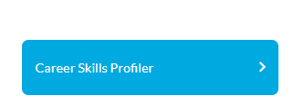
The Career Skills Profiler
Step 1: Click on the Career Skills app
Step 3: Go through the questionnaire and
click the number 1-5 that describes you best…
Step 2: Start the Profiler

Slide 10
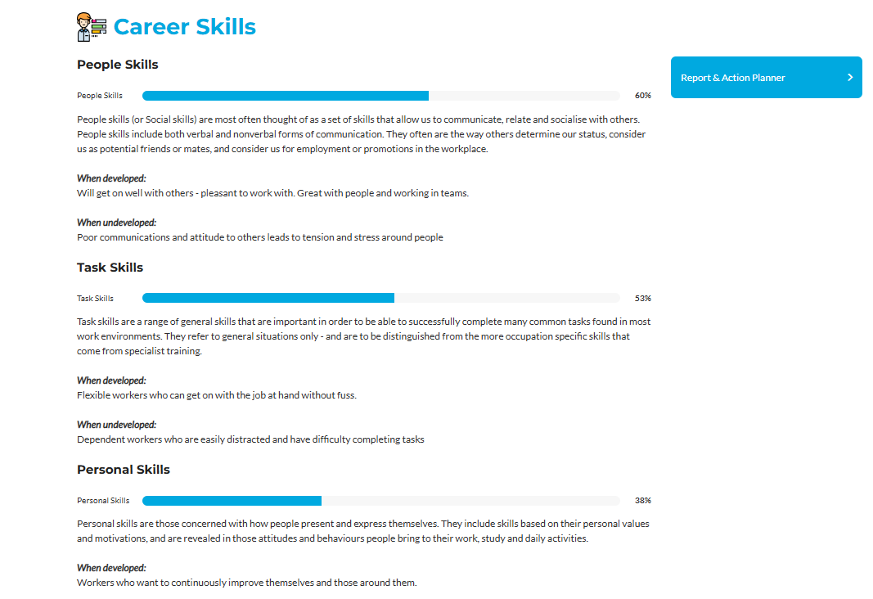
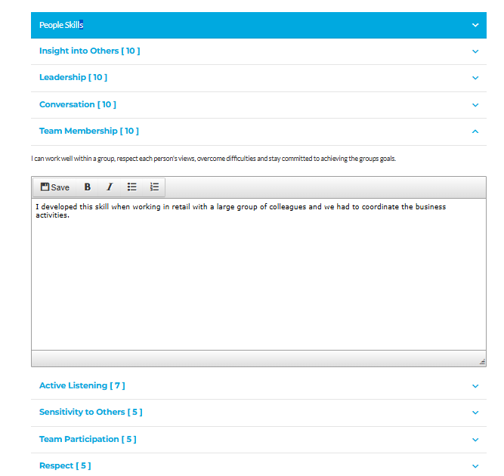
Your Career Skills Results, Reflections and Report
Step 1: View your Results and click Report and Action Planner
Step 2: Type in evidence of skills
developed or skills to improve

Slide 11

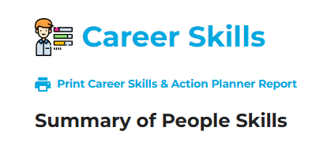
Step 3: Print or Save you full Career Skills Report

Slide 12
Understand what is meant by the term ‘Career Skills’ or ‘Transferable Skills”
Reflect on 26 top career skills divided across People, Task and Personal skills.
Reflect on what is your current level is in each of these (Undeveloped, Some or Much Experience).
Discuss your top skills and ones for further and future development.

